Slide 1
Identification of Plant Species from Seedling Images
Sam Wheating

Slide 2
Primary Source
[1]S. Lee, C. Chan, S. Mayo and P. Remagnino, "How Deep Learning Extracts and Learns Leaf Features for Plant Classification", Pattern Recognition, 2017. Examines the use of a convolutional neural network (CNN) in plant species classification. By deconvolution of the CNN it can be observed that the most identifiable feature in plants is actually the venation (vein structure).

Slide 3
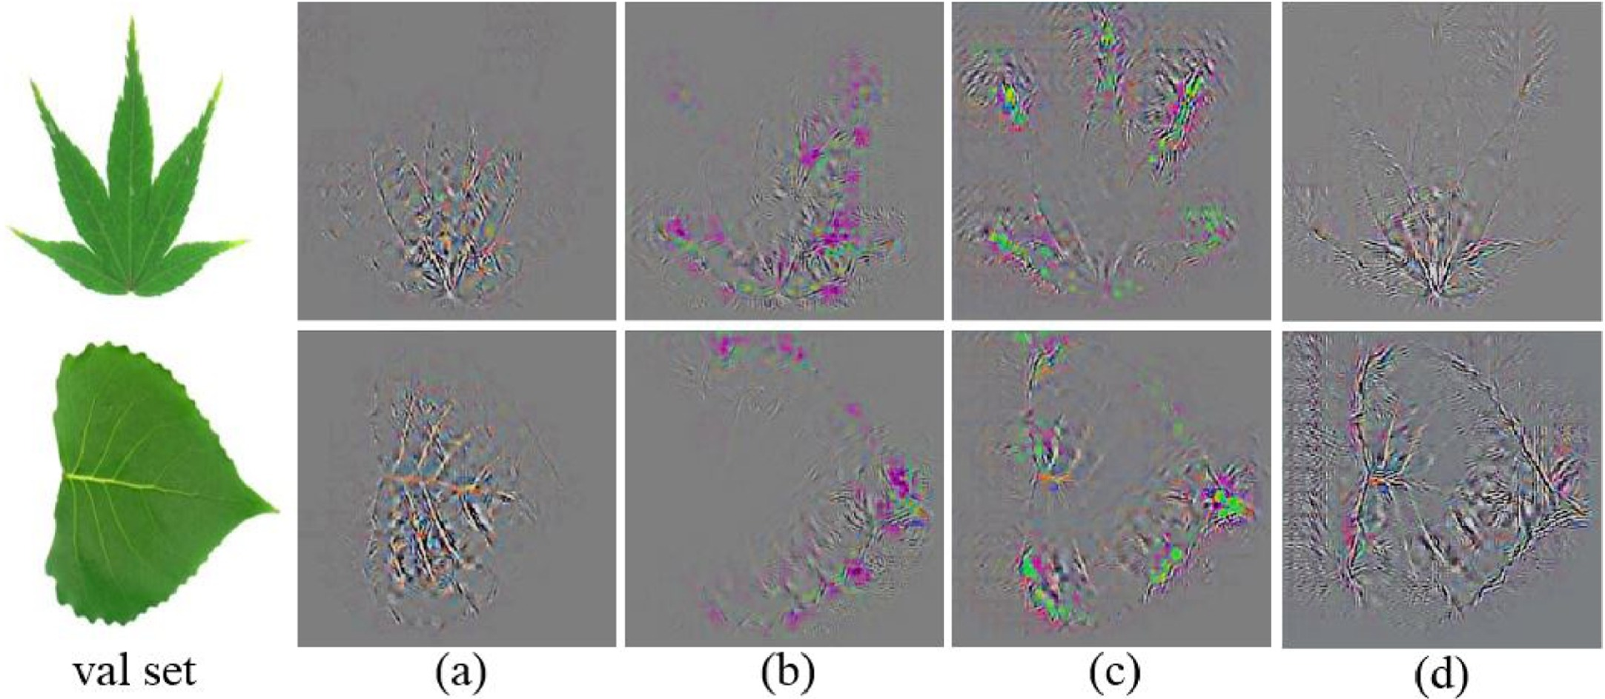
“In the first experiment we show that venation structure is a very important feature for identification especially when shape feature alone is inadequate.”

Slide 4
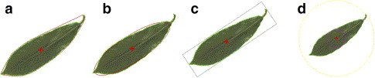
Secondary Source
[2]J. Du, X. Wang and G. Zhang, "Leaf shape based plant species recognition", Applied Mathematics and Computation, vol. 185, no. 2, pp. 883-893, 2007.
A set of metrics is automatically obtained from each image, then standardized and used in a hypersphere classifier (Multidimensional KNN).

Slide 5
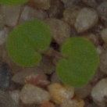
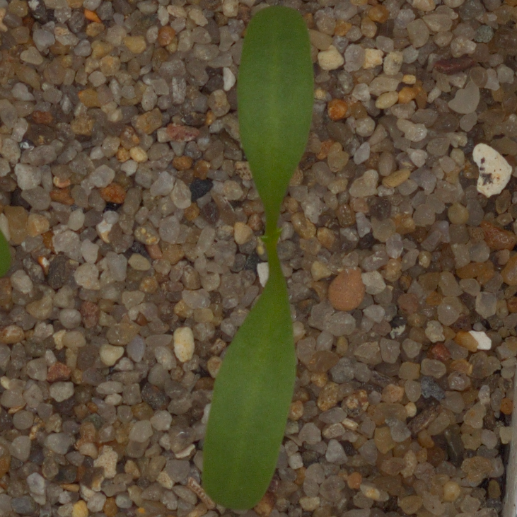
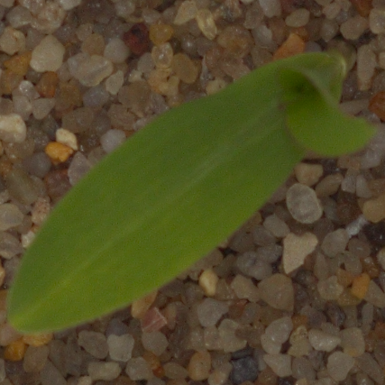
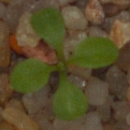
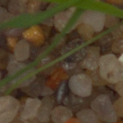
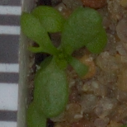
Dataset:
Kaggle Competition: Plant Seedlings Classification “The Aarhus University Signal Processing group, in collaboration with University of Southern Denmark, has recently released a dataset containing images of approximately 960 unique plants belonging to 12 species at several growth stages.”

Slide 6
Possible problems
Background subtraction - Must be able to accurately remove gravel from base images.
Low resolution images - Maybe required to remove images which are too low-resolution from the training set.
Feature Amplification - Must be able to accurately isolate vascular patterns from the leaves.

